Slide 1
Self-sufficient deployment: using pair programming to have fun and sell your solutions
Kristin Carr
Kris Fabick

Slide 2
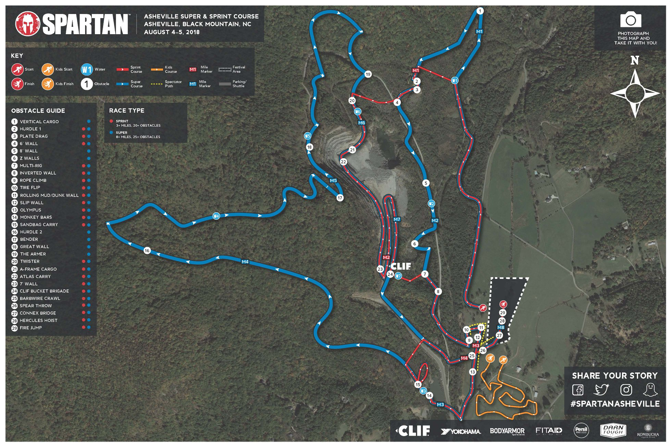
Black Mountain: Stronger Together
25+ obstacles/ 12 miles

Slide 3

Black Mountain: Stronger Together
25+ obstacles/ 12 miles
7 "mystery" obstacles

Slide 4

Black Mountain: Stronger Together
25+ obstacles/ 12 miles
7 "mystery" obstacles
1636 ft elevation change

Slide 5
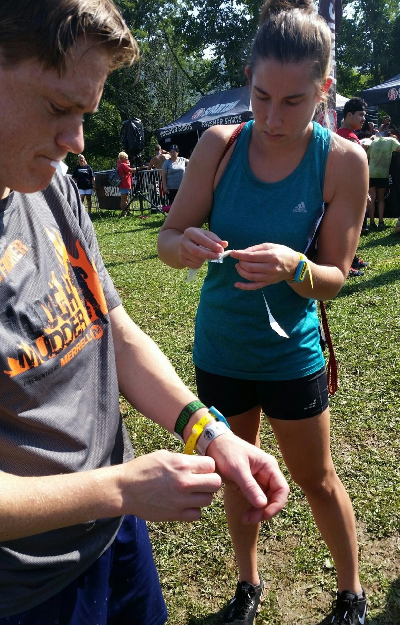
Black Mountain: Stronger Together
25+ obstacles/ 12 miles
7 "mystery" obstacles
1636 ft elevation change
Preparation (stability)
Adaptability (reactivity)
Overcome Difficulty (mindset)

Slide 6
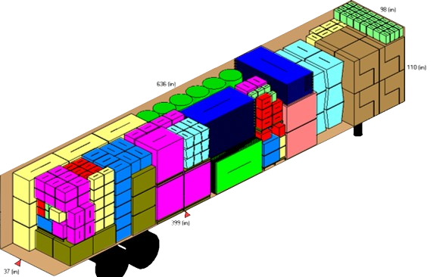

Our Spartan Race at Work
Business problem: Predict monthly “Container Fill Ratio” based on package dimensions

Slide 7
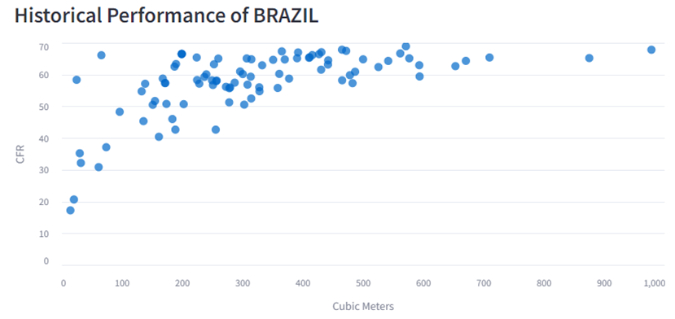
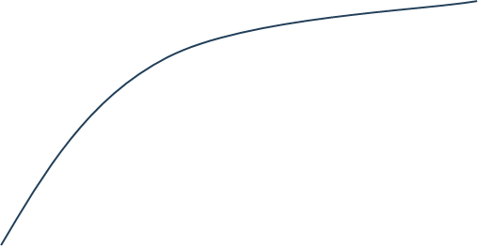
Simple, right?

Slide 8
Analytics Deployment Expansion Curve
Manual /
ad hoc
Local deployment
Team/Dept server deployment
Dept system deployment
Enterprise system deployment

Slide 9
Analytics Deployment Expansion Curve
Reactivity
Dedicated Support
Retain maximum reactivity with sufficient support to ensure stability
Manual /
ad hoc
Local deployment
Team/Dept server deployment
Dept system deployment
Enterprise system deployment

Slide 10
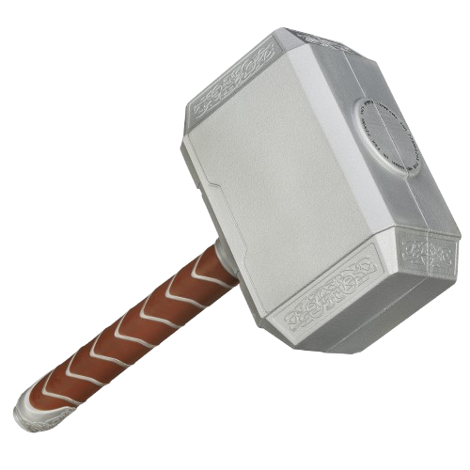
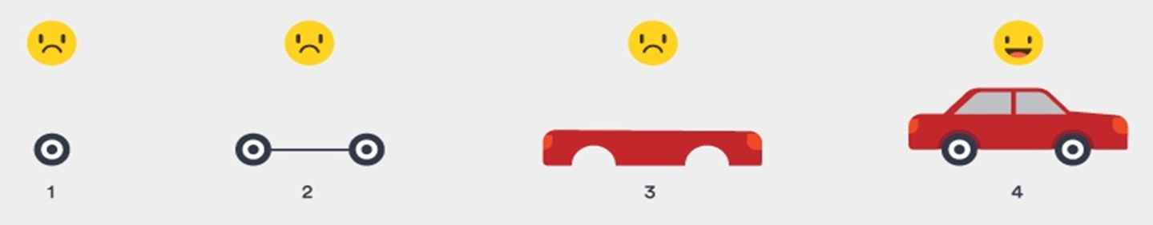
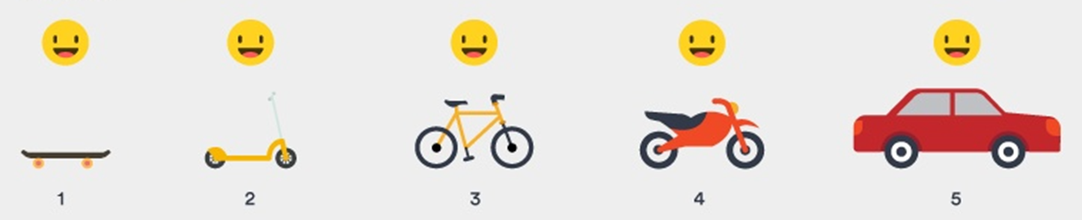
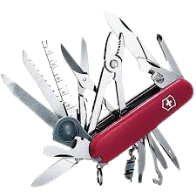
Problem 1: Solutions need to be REACTIVE
Tool we wish we had
ADMIN
Tools we actually have

Slide 11
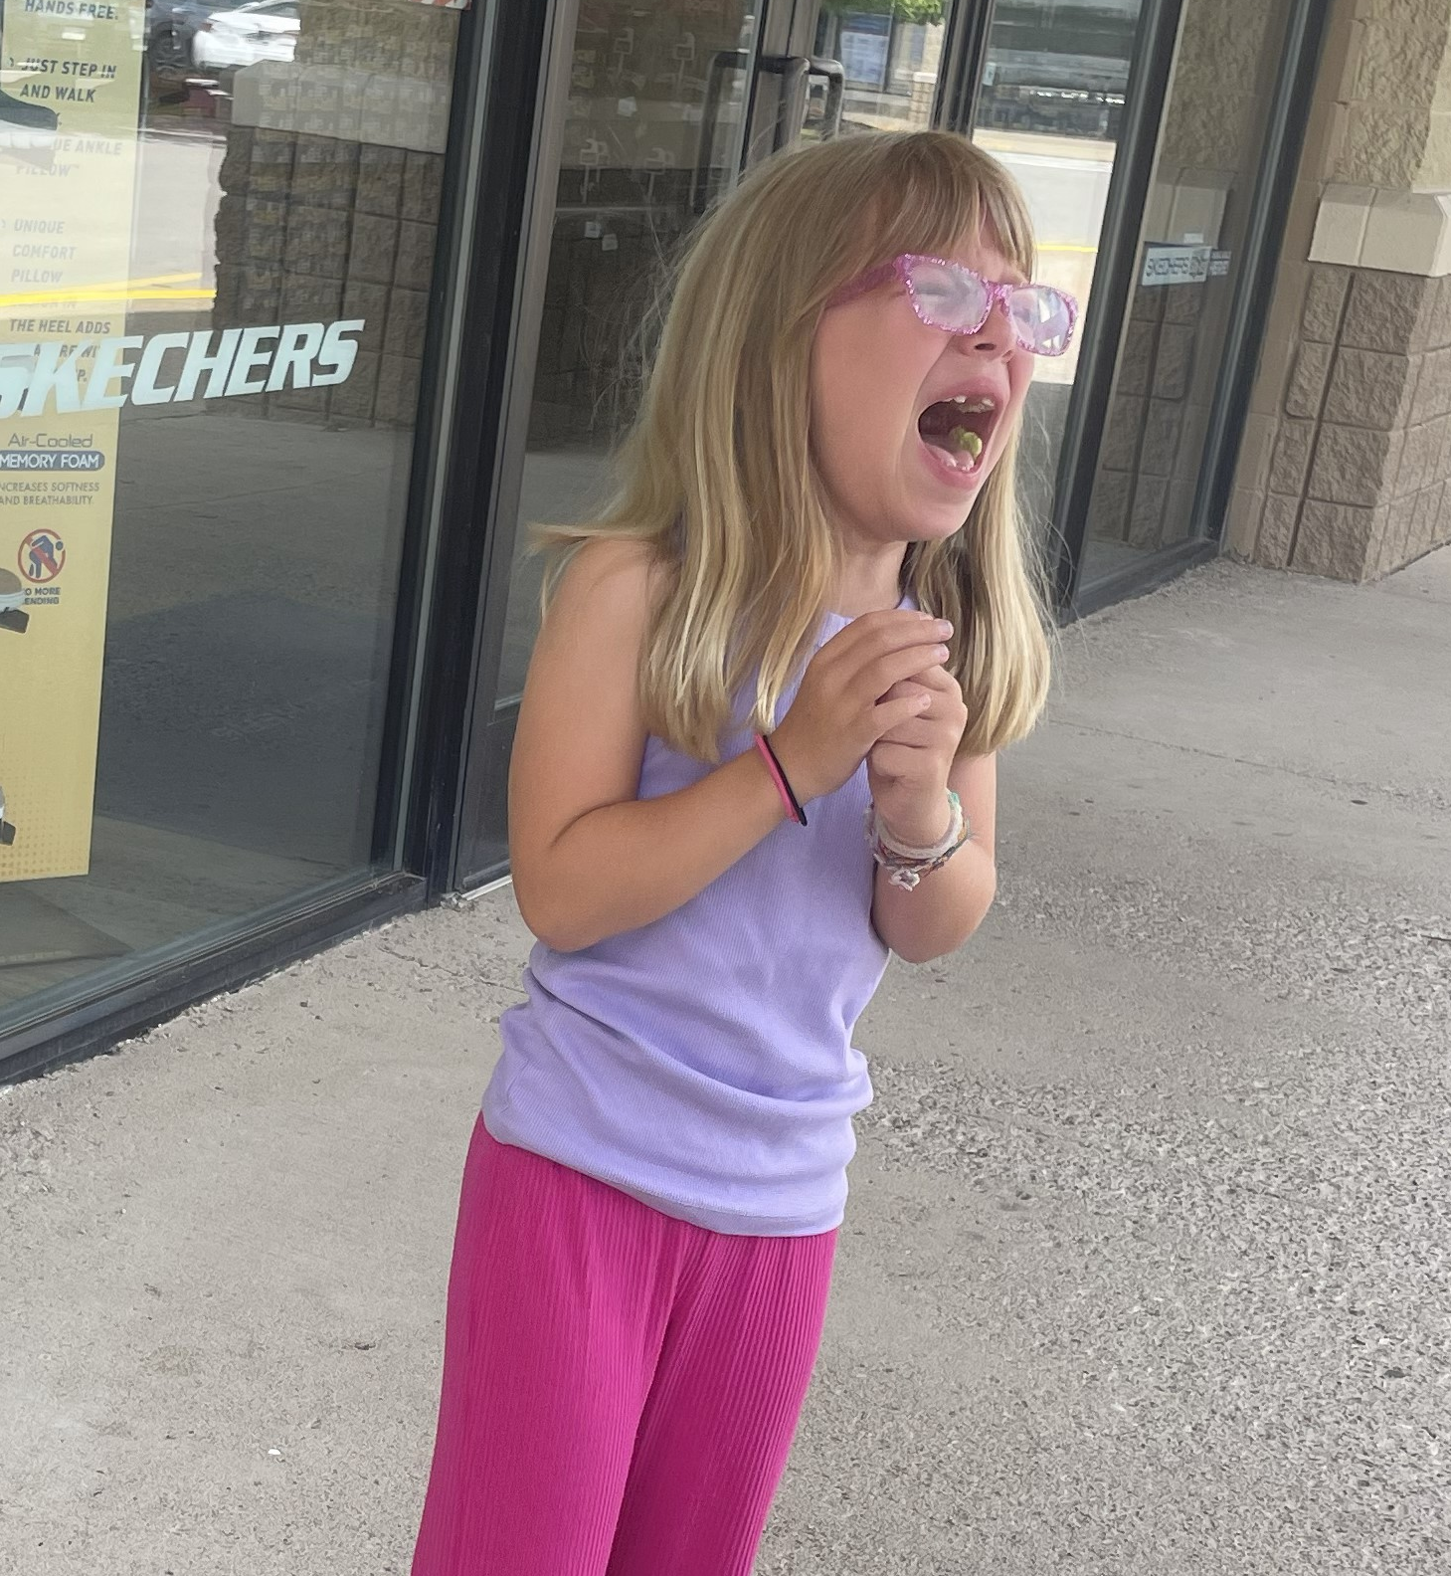


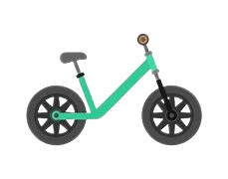
Problem 2: Solutions need to be STABLE
Stability requires sufficient support
(Or else everyone is angry crying)

Slide 12


Embrace the Paradox: Pair Programming to the Rescue
15% more time with 15% less defects
90% preferred working in pairs
Solo developers passed ~75% of test cases
Paired developers passed ~90% of test cases
REACTIVE
STABLE
https://medium.com/the-liberators/in-depth-the-costs-and-benefits-of-pair-programming-b4b54b27c6ff

Slide 13





The Path to Victory
Develop Model
Pin Model Version
Create API
KF lead
KC lead
Learn together
Call API
Display Model Preds
3 weeks
+
2 weeks
+
1 day

Slide 14

How does pair programming NOT look?
Backseat driving

Slide 15

How does pair programming NOT look?
Backseat driving
24/7 grind

Slide 16

How does pair programming NOT look?
Backseat driving
24/7 grind
Hogging the keyboard

Slide 17

How does pair programming NOT look?
Backseat driving
24/7 grind
Hogging the keyboard
Nap time

Slide 18
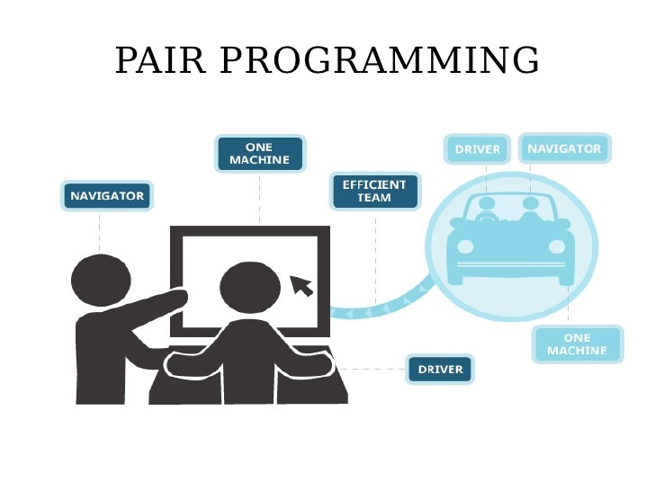
How does pair programming look?
Many approaches
Driver/navigator

Slide 19
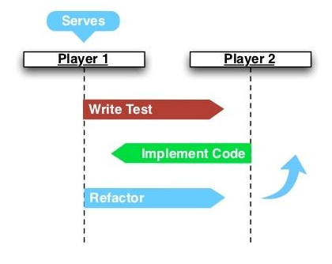
How does pair programming look?
Many approaches
Driver/navigator
Ping/Pong
"Refactoring" is the process of making the code more readable, maintainable, and efficient

Slide 20




How does pair programming look?
Many approaches
Driver/navigator
Ping/Pong
Unstructured Synchronous
Exploratory Analysis
Refactor
Model Building
Refactor
UI App Creation
Refactor
"Refactoring" is the process of making the code more readable, maintainable, and efficient

Slide 21
How does pair programming look?
Exploratory Analysis
Many approaches
Driver/navigator
Ping/Pong
Unstructured Synchronous
Unstructured Asynchronous ("Pair"allel)
UI App Creation
Model Building
Refactor
Refactor
"Refactoring" is the process of making the code more readable, maintainable, and efficient

Slide 22

Lesson #1: “Pairing” is a mindset, not a technique
Follow the vibe

Slide 23


Lesson #1: “Pairing” is a mindset, not a technique
Follow the vibe
Embrace friction

Slide 24


Lesson #1: “Pairing” is a mindset, not a technique
Follow the vibe
Embrace friction
Slow down to speed up

Slide 25
Lesson #2: Know Your Strengths; Adapt for Your Weaknesses
Before Pair Programming
After Pair Programming

Slide 26


Lesson #3: Create Checkpoints
Refactor often

Slide 27
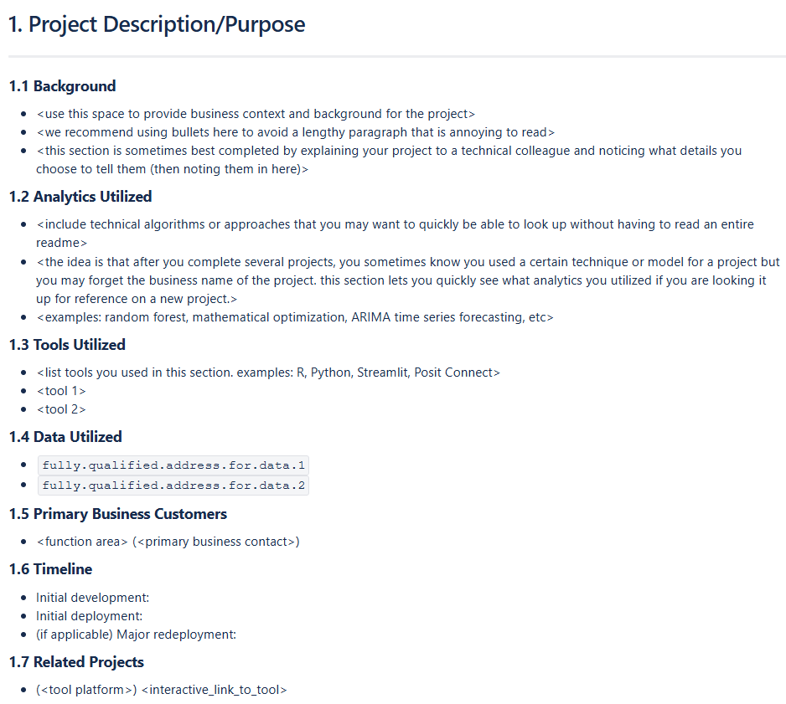
Lesson #3: Create Checkpoints
Refactor often
Implement standards

Slide 28

Lesson #3: Create Checkpoints
Refactor often
Implement standards
Slow down to speed up (reprise)
If you want to go fast, go alone.
If you want to go far, go together.

Slide 29

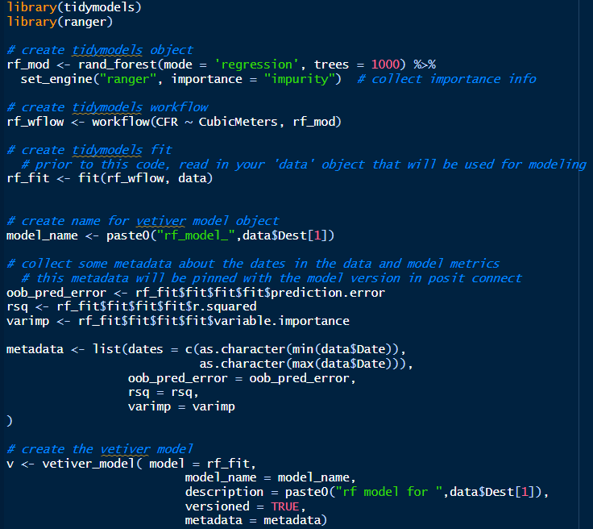
The Technical Details
Develop Model
Configure Posit Connect
Pin Model to Posit Connect
Create Vetiver API
Call Vetiver API
Display Model Predictions

Slide 30
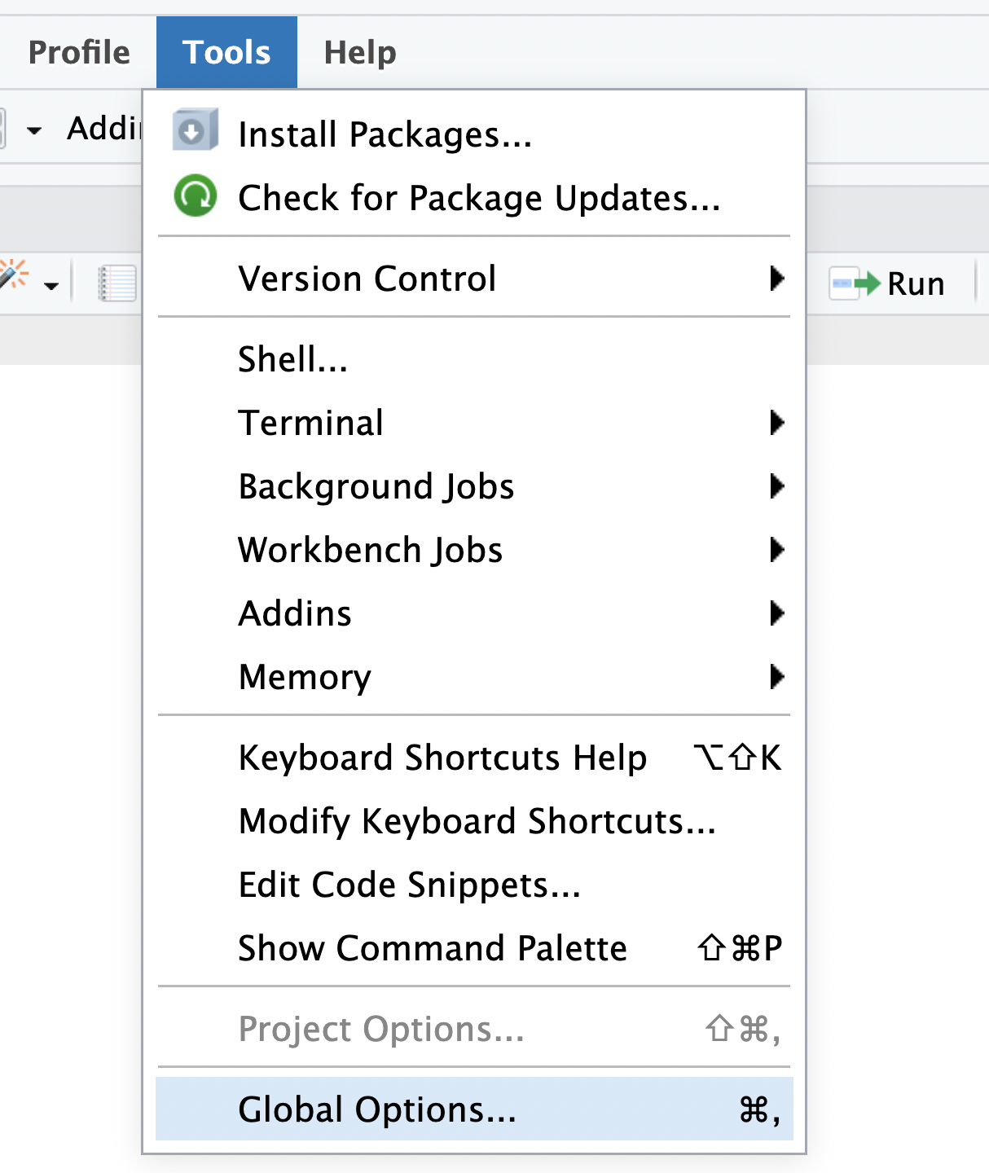
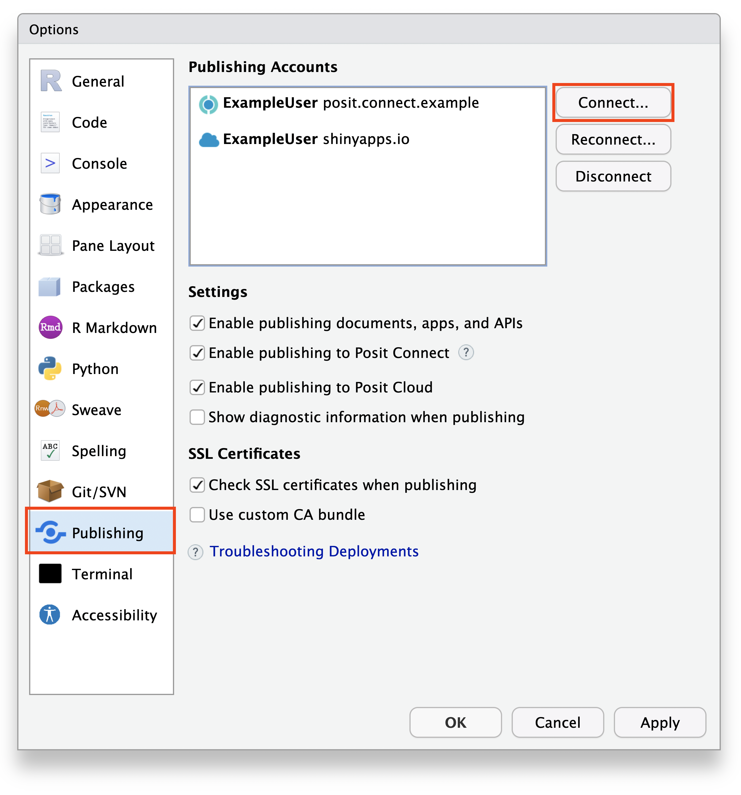
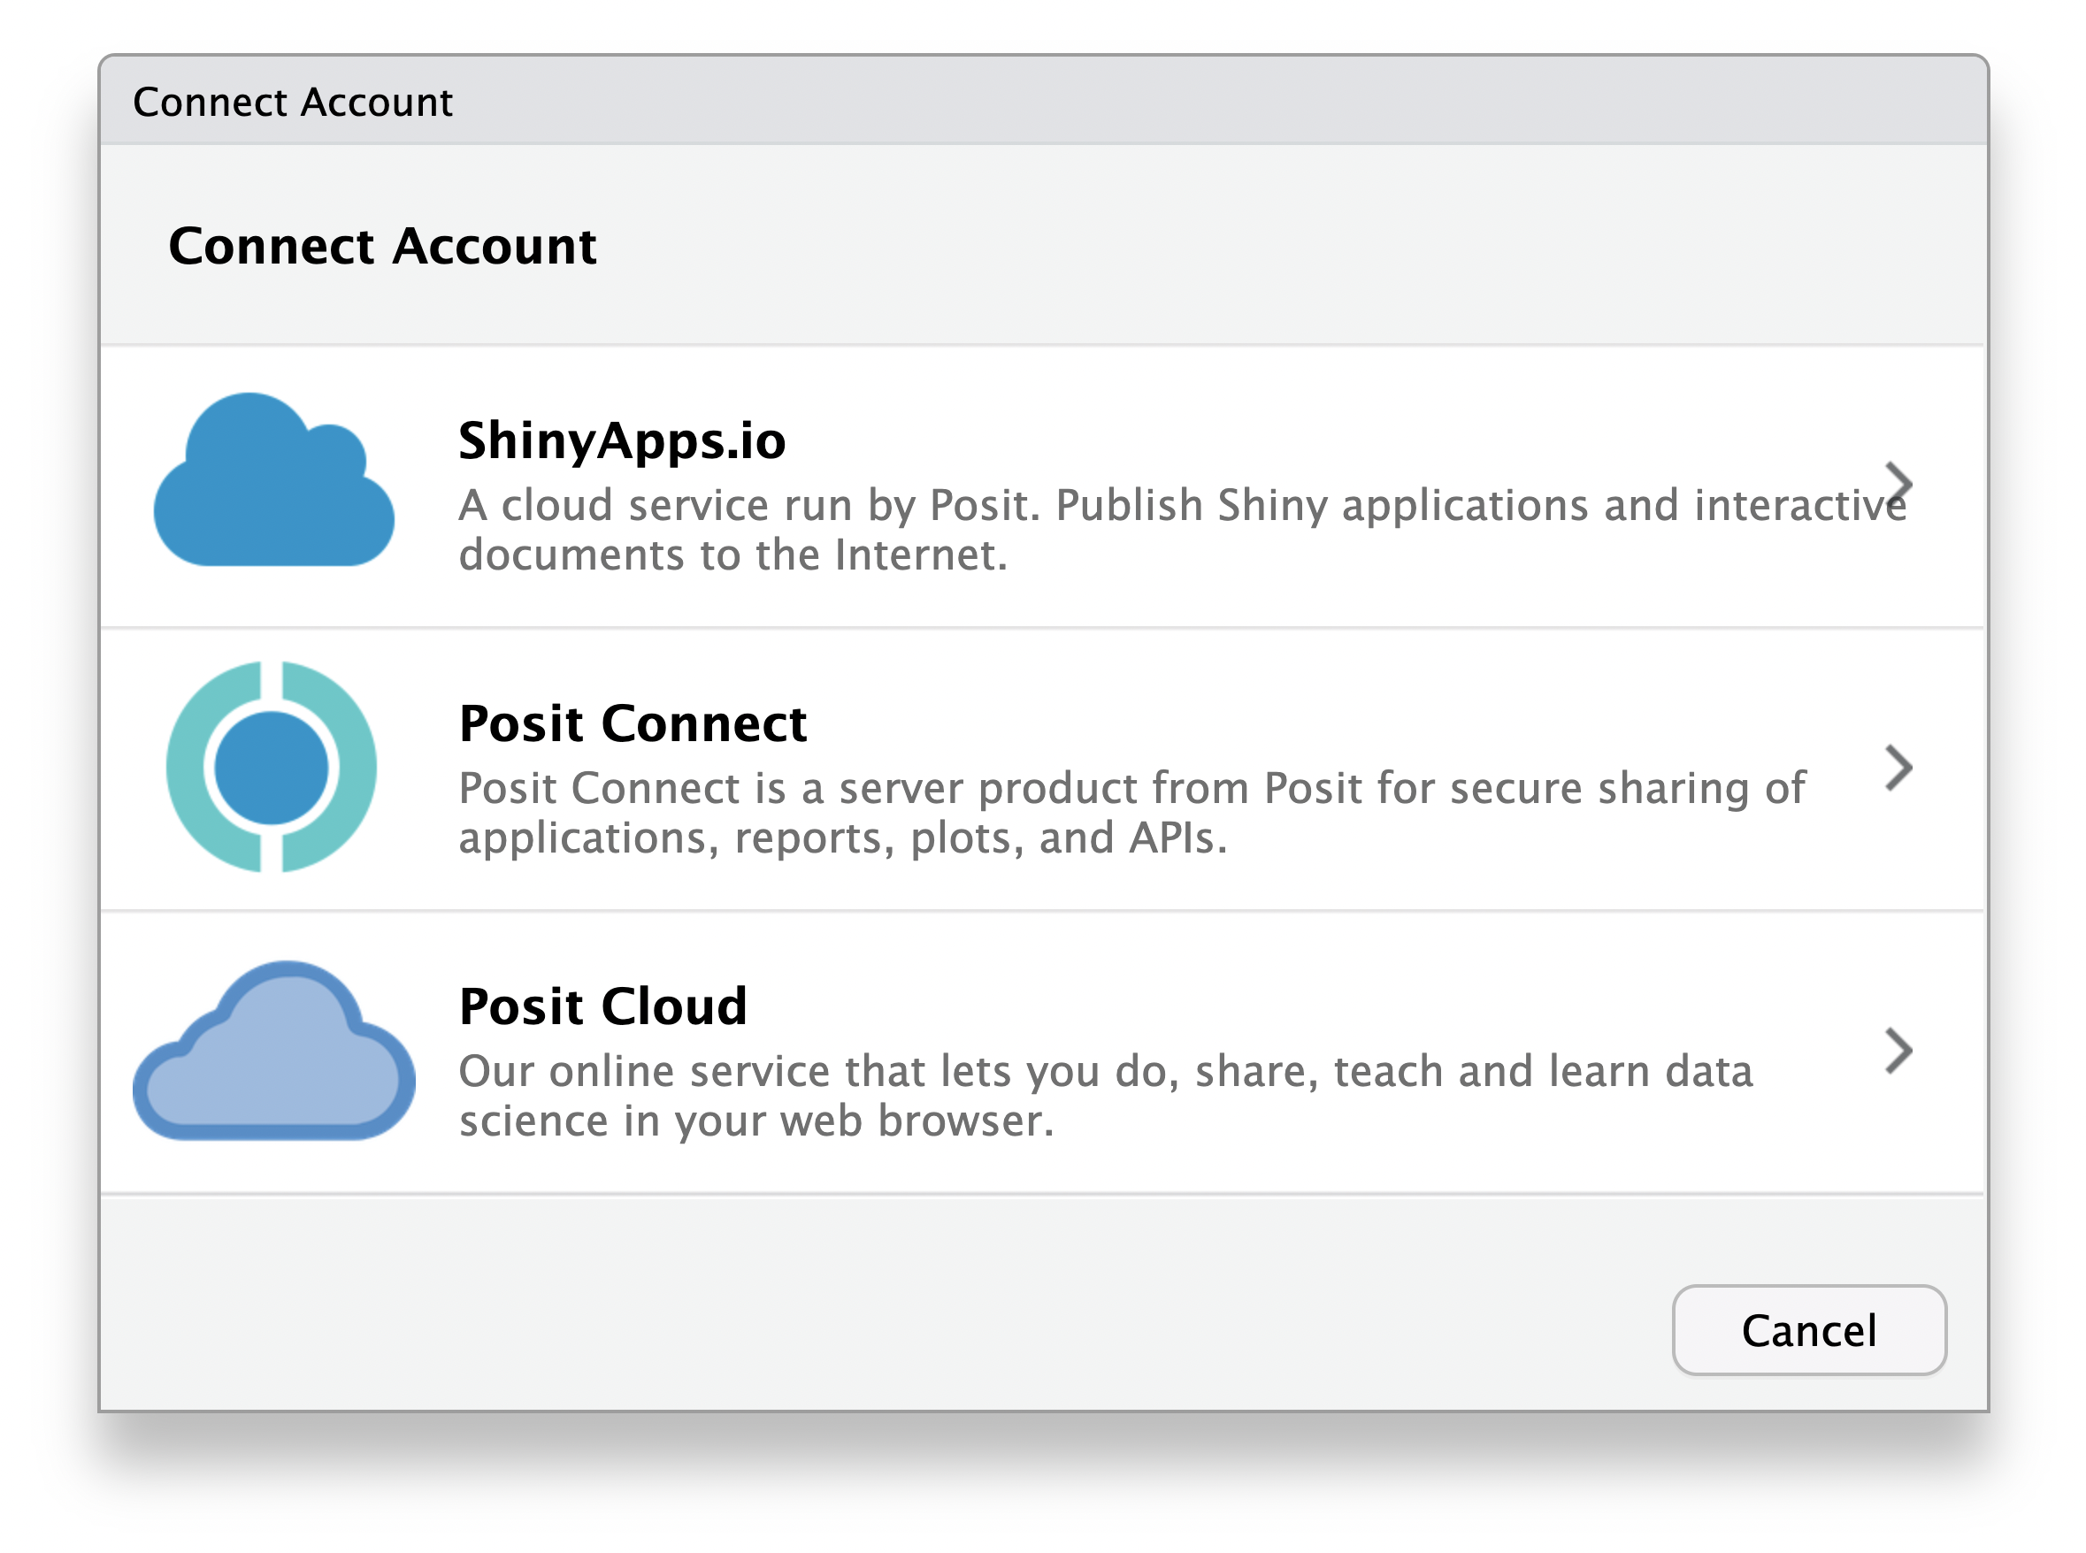
The Technical Details
Develop Model
Configure Posit Connect
Pin Model to Posit Connect
Create Vetiver API
Call Vetiver API
Display Model Predictions
https://docs.posit.co/ide/user/ide/guide/publish/connecting.html
1
2
3

Slide 31
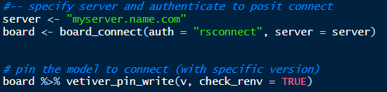
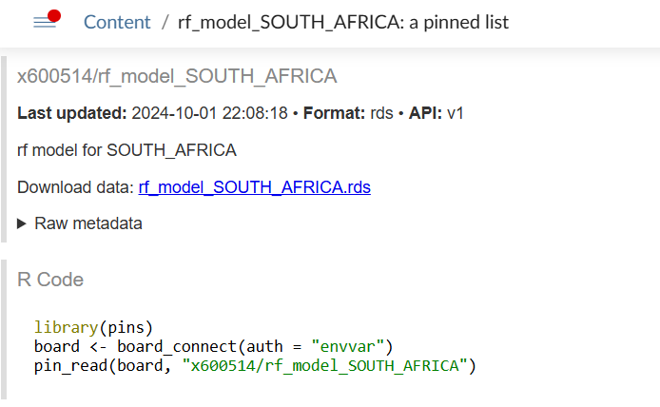
The Technical Details
Develop Model
Configure Posit Connect
Pin Model to Posit Connect
Create Vetiver API
Call Vetiver API
Display Model Predictions
R code to pin the model
Posit Connect view of pinned model
Notice the metadata section
Posit Connect provides the code you need to read the model

Slide 32
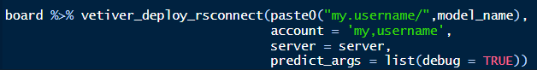
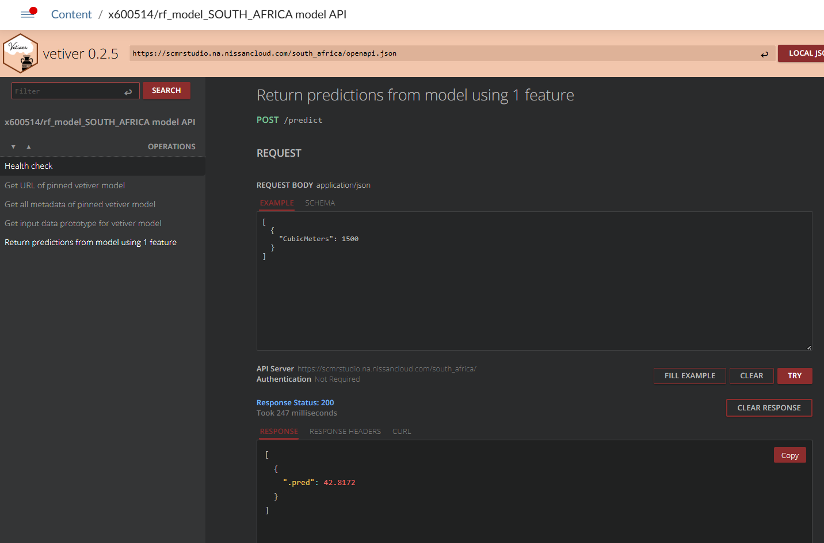
The Technical Details
https://docs.posit.co/connect/user/vetiver/
Develop Model
Configure Posit Connect
Pin Model to Posit Connect
Create Vetiver API
Call Vetiver API
Display Model Predictions
R code to create vetiver API Posit Connect view of API
Vetiver creates endpoints for:
GET /ping
GET /pin-url
GET /metadata
GET /prototype
POST /predict

Slide 33
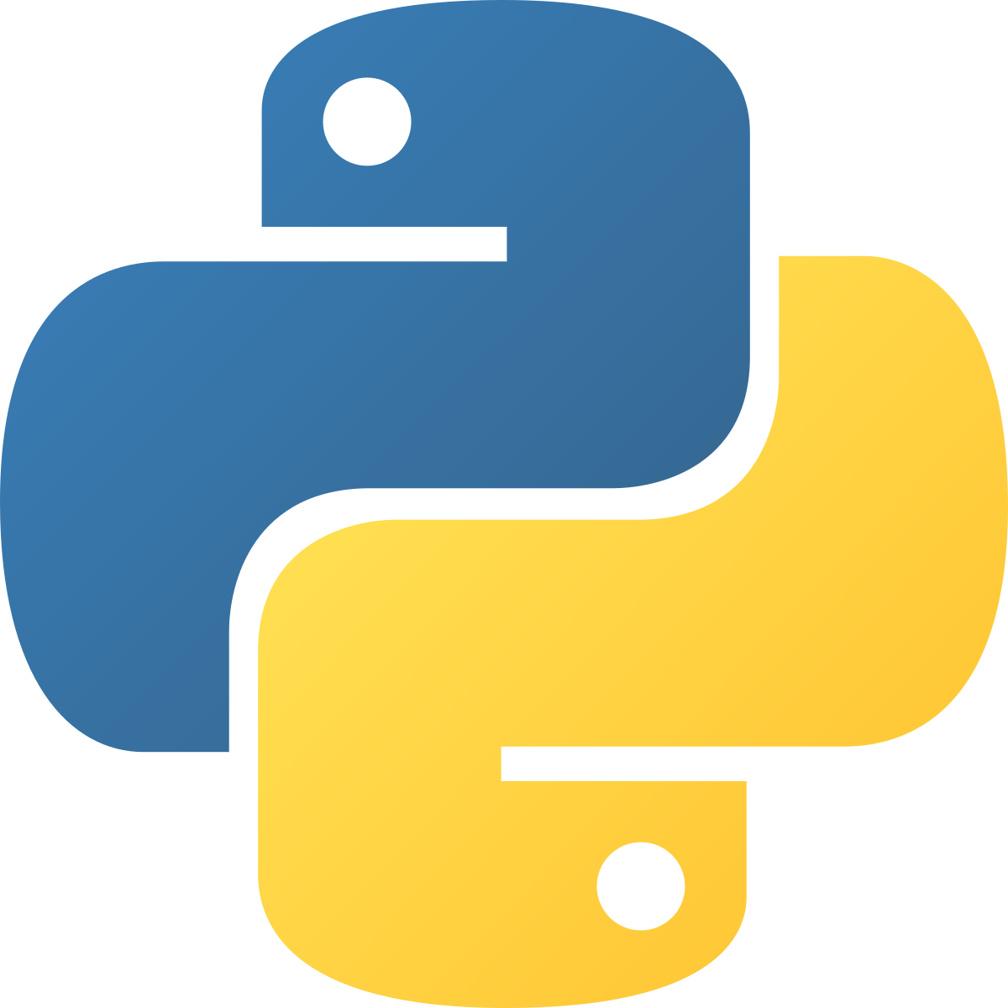
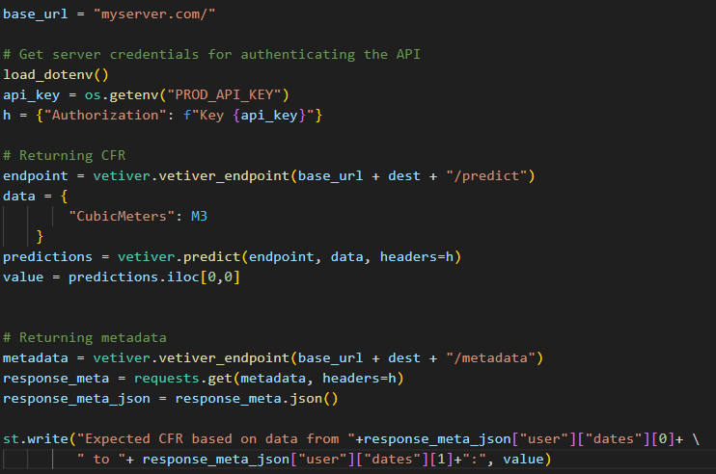
The Technical Details
Develop Model
Configure Posit Connect
Pin Model to Posit Connect
Create Vetiver API
Call Vetiver API
Display Model Predictions

Slide 34
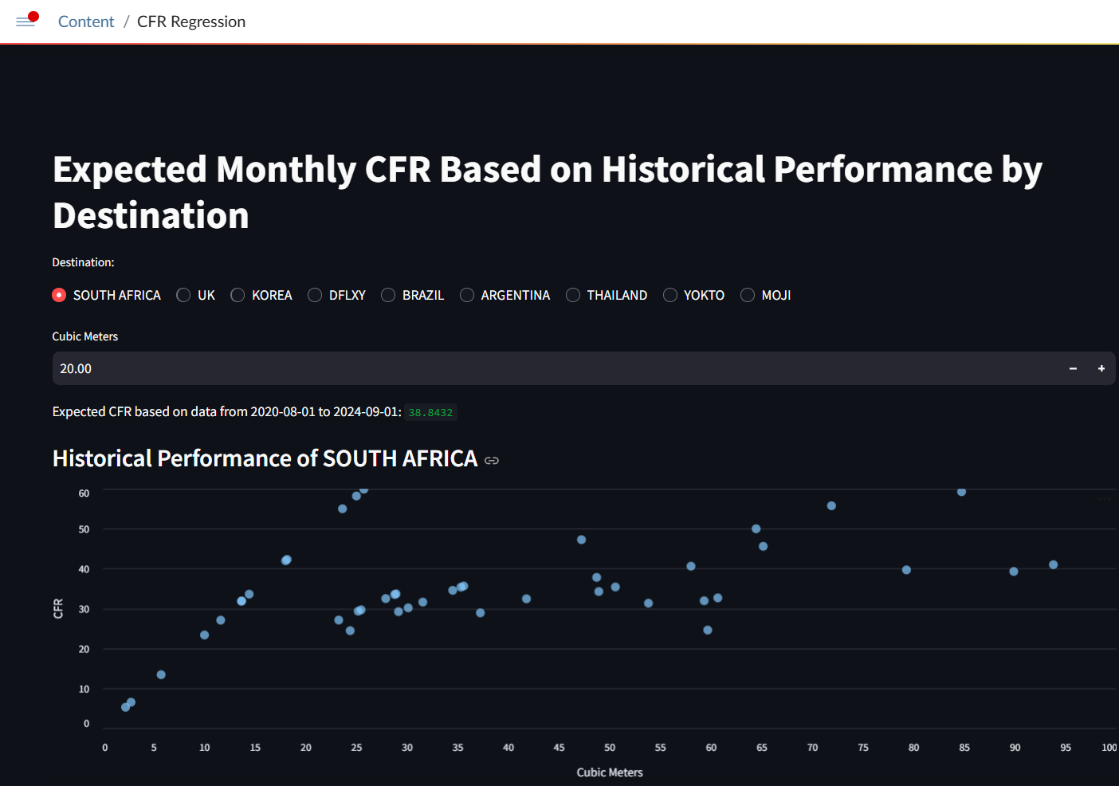
The Technical Details
Develop Model
Configure Posit Connect
Pin Model to Posit Connect
Create Vetiver API
Call Vetiver API
Display Model Predictions

Slide 35


Want to Learn More?

